Slide 1
A Data Analysis of Bus Journey Variability in Dublin
Final Year Project – Owen Duffy

Slide 2
Introduction
Cliff notes/ synopsis
Aims
Personal Investment/Motivation

Slide 3
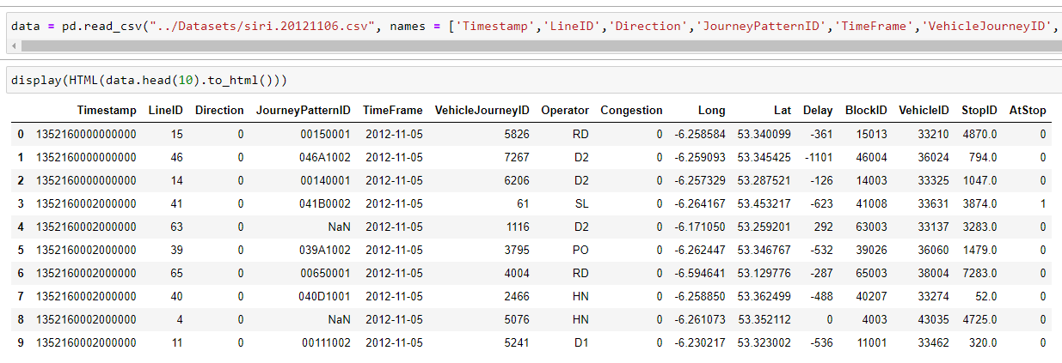
Dataset

Slide 4
Dataset columns
Timestamp micro since 1970 01 01 00:00:00 GMT,
Line ID,
Direction,
Journey Pattern ID,
Time Frame (The start date of the production time table - in Dublin the production time table starts at 6am and ends at 3am),
Vehicle Journey ID (A given run on the journey pattern)
Operator (Bus operator, not the driver),
Congestion [0=no,1=yes],
Lon WGS84,
Lat WGS84,
Delay (seconds, negative if bus is ahead of schedule),
Block ID (a section ID of the journey pattern),
Vehicle ID,
Stop ID,
At Stop [0=no,1=yes]
Thanks to Michael Cullen for providing me with this key.

Slide 5
Reference to Danish Paper

Slide 6
Initial attempts and Issues with dataset

Slide 7
Multithreading

Slide 8
GPU Acceleration and Cloud Computing

Slide 9
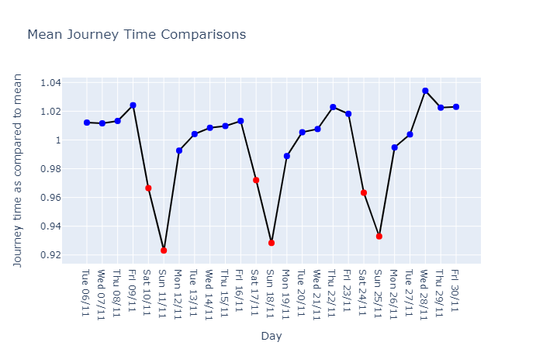
Means Compared across days

Slide 10
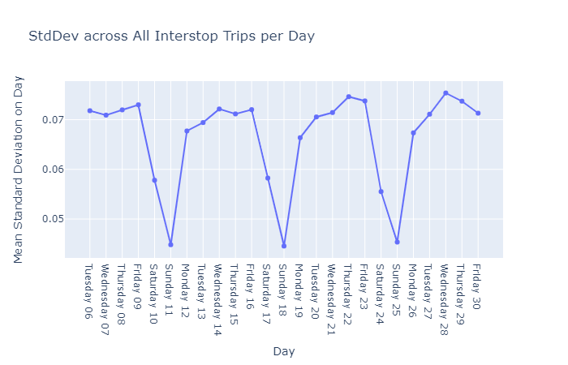
Std Dev across days
Explain what the data is
Explain how data produced
Caveats

Slide 11
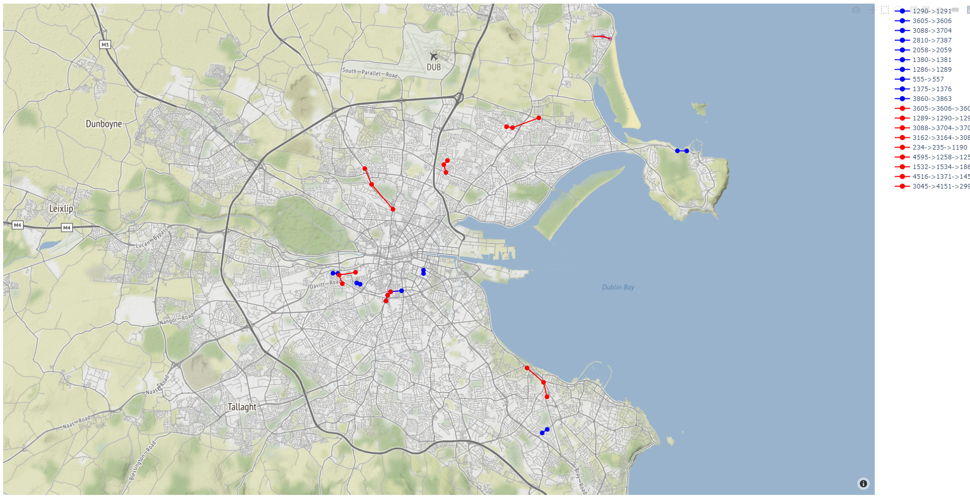

Slide 12
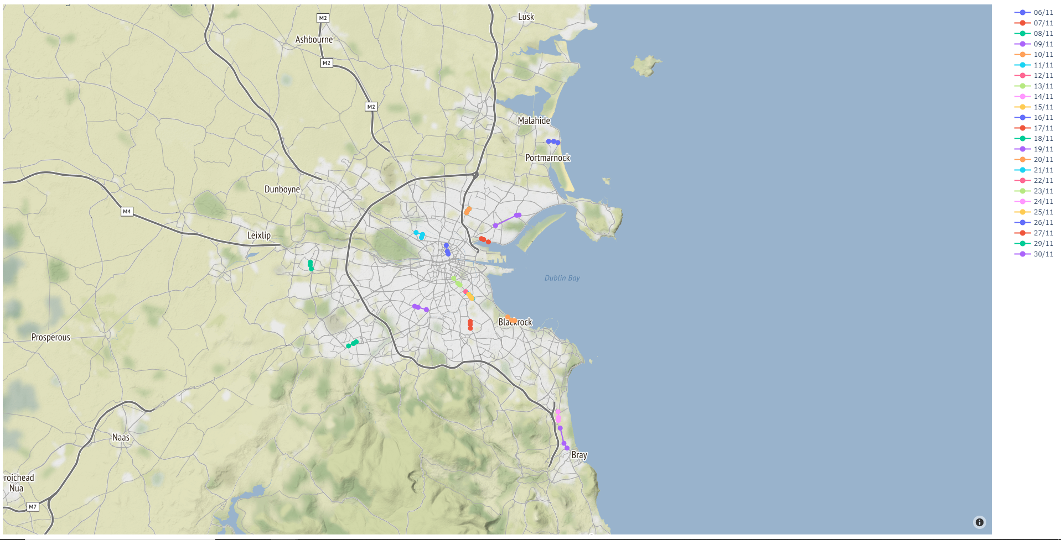

Slide 13
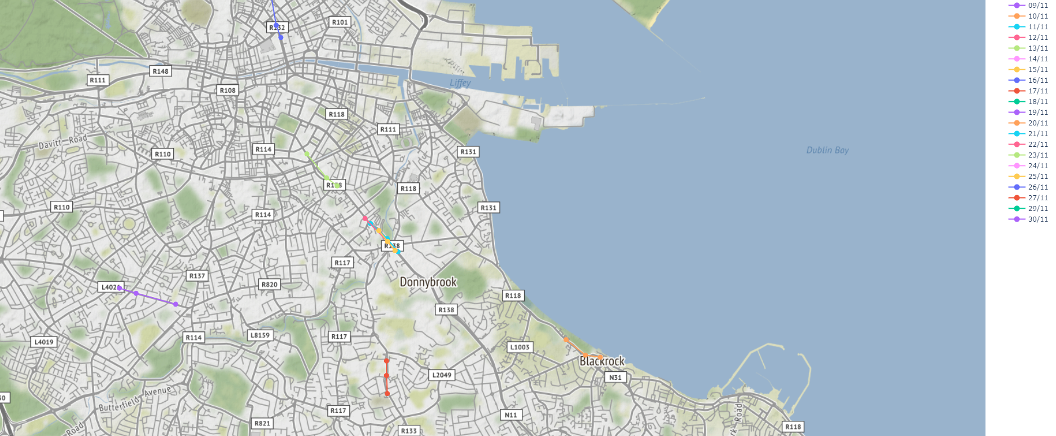
Analysis identifying Donnybrook as Problem Area

Slide 14
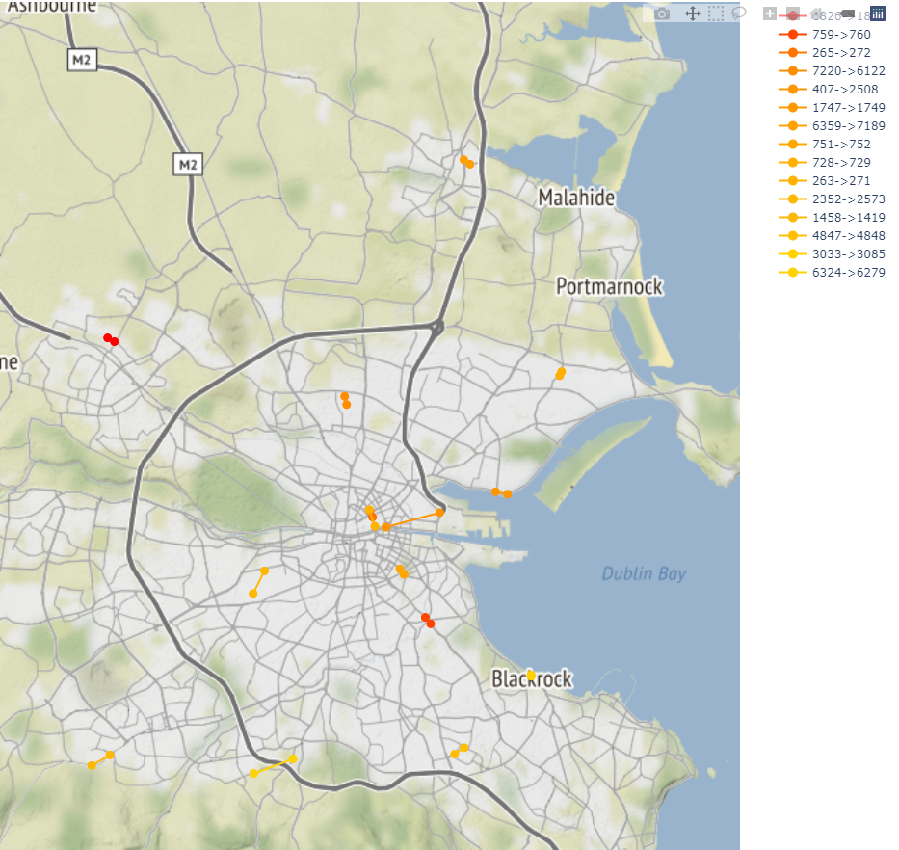
Most Variable Routes by Day 11/11/2012

